Slide 1

I/O Streams
Notes:
Just into on why we’re here today and what’s the point of having this presentation. Brifely touch the topic of presenters: SZ, OZ, IL, and KK.
In the end: passing the floot to Sviatlana.

Slide 2
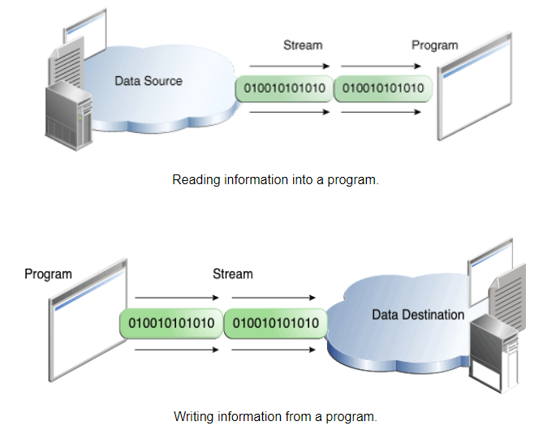
I/O Streams
An I/O Stream represents an input source or an output destination. A stream can represent many different kinds of sources and destinations, including disk files, devices, other programs, and memory arrays.
Streams support many different kinds of data, including simple bytes, primitive data types, localized characters, and objects. Some streams simply pass on data, others manipulate and transform the data in useful ways.
No matter how they work internally, all streams present the same simple model to programs that use them: A stream is a sequence of data.
The data source and data destination pictured can be anything that holds, generates, or consumes data. Obviously this includes disk files, but a source or destination can also be another program, a peripheral device, a network socket, or an array.

Slide 3
I/O Types
Byte Streams
Character Streams

Slide 4
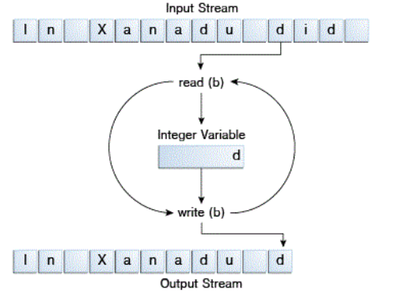
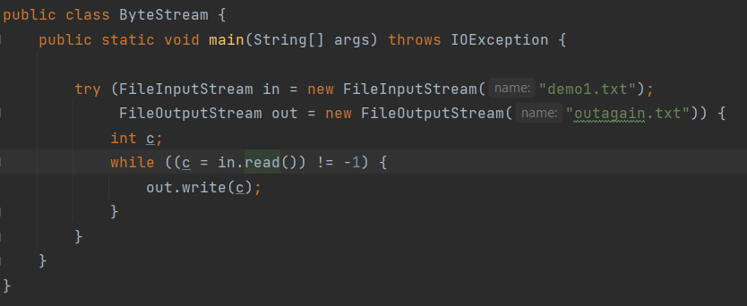
Byte Streams
Programs use byte streams to perform input and output of 8-bit bytes. All byte stream classes are descended from InputStream and OutputStream.
ByteStream spends most of its time in a simple loop that reads the input stream and writes the output stream, one byte at a time, as shown in the following figure. Method read() returns –1 when the end of file is reached.
Closing a Stream is important, so use try-with-resources when working with Streams.
All other stream types are built on byte streams.

Slide 5
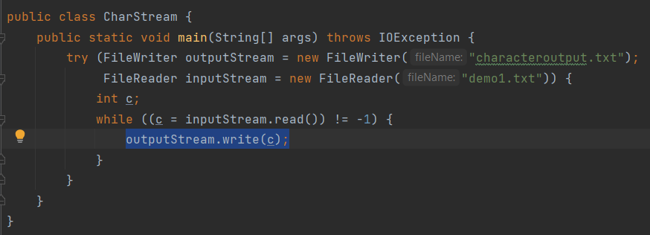
Character Streams
All character stream classes are descended from Reader and Writer. As with byte streams, there are character stream classes that specialize in file I/O: FileReader and FileWriter.
Character streams are often "wrappers" for byte streams. The character stream uses the byte stream to perform the physical I/O, while the character stream handles translation between characters and bytes. FileReader, for example, uses FileInputStream, while FileWriter uses FileOutputStream.

Slide 6
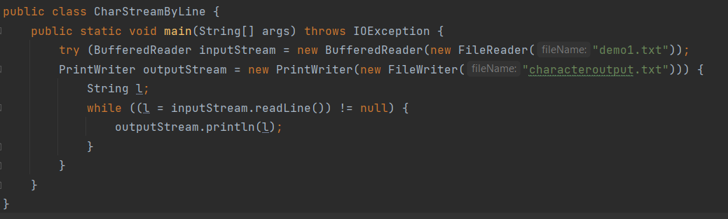
Character Streams
Character I/O usually occurs in bigger units than single characters. One common unit is the line: a string of characters with a line terminator at the end. A line terminator can be a carriage-return/line-feed sequence ("\r\n"), a single carriage-return ("\r"), or a single line-feed ("\n"). Supporting all possible line terminators allows programs to read text files created on any of the widely used operating systems.
Invoking readLine returns a line of text with the line. OutputStream propagates each line using println(), which appends the line terminator for the current operating system. This might not be the same line terminator that was used in the input file.
There are many ways to structure text input and output beyond characters and lines.

Slide 7
Using Buffers
Most of the examples we've seen so far use unbuffered I/O. This means each read or write request is handled directly by the underlying OS. This can make a program much less efficient, since each such request often triggers disk access, network activity, or some other operation that is relatively expensive.
To reduce this kind of overhead, the Java platform implements buffered I/O streams. Buffered input streams read data from a memory area known as a buffer; the native input API is called only when the buffer is empty. Similarly, buffered output streams write data to a buffer, and the native output API is called only when the buffer is full.
A program can convert an unbuffered stream into a buffered stream using the wrapping idiom, where the unbuffered stream object is passed to the constructor for a buffered stream class.
inputStream = new BufferedReader(new FileReader("demo1.txt")); outputStream = new BufferedWriter(new FileWriter("characteroutput.txt"));
There are four buffered stream classes used to wrap unbuffered streams: BufferedInputStream and BufferedOutputStream create buffered byte streams, while BufferedReader and BufferedWriter create buffered character streams.
It often makes sense to write out a buffer at critical points, without waiting for it to fill. This is known as flushing the buffer.
Some buffered output classes support autoflush, specified by an optional constructor argument. When autoflush is enabled, certain key events cause the buffer to be flushed. For example, an autoflush PrintWriter object flushes the buffer on every invocation of println or format.
To flush a stream manually, invoke its flush method. The flush method is valid on any output stream, but has no effect unless the stream is buffered.

Slide 8
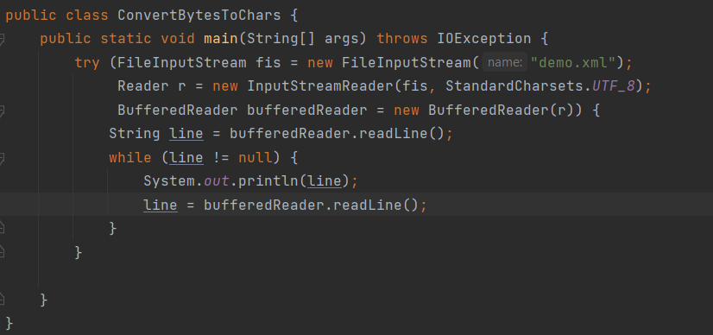
Stream combination
You can combine streams into chains to achieve more advanced input and output operations. For instance, reading every byte one at a time from a file is slow. It is faster to read a larger block of data from the disk and then iterate through that block byte for byte afterwards. To achieve buffering you can wrap your InputStream in an BufferedInputStream.
Buffering is just one of the effects you can achieve by combining streams. You can also wrap your InputStream in a PushbackStream. That way you can push data back into the stream to be re-read later. This is sometimes handy during parsing. Or, you can combine two InputStreams into one using the SequenceInputStream.

Slide 9
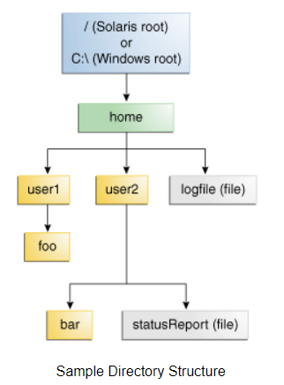
Working with File System
A file system stores and organizes files on some form of media, generally one or more hard drives, in such a way that they can be easily retrieved. Most file systems in use today store the files in a tree (or hierarchical) structure. At the top of the tree is one (or more) root nodes. Under the root node, there are files and directories (folders in Microsoft Windows). Each directory can contain files and subdirectories, which in turn can contain files and subdirectories, and so on, potentially to an almost limitless depth.
A file is identified by its path through the file system beginning from the root node.
A path is either relative or absolute. An absolute path always contains the root element
and the complete directory list required to locate the file.
A relative path needs to be combined with another path in order to access a file.

Slide 10
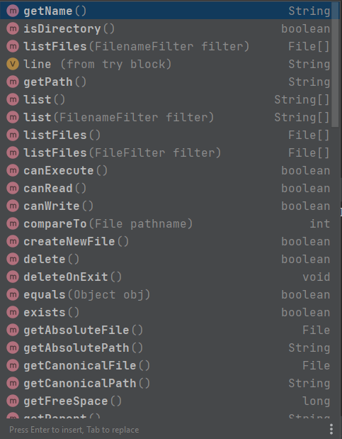
File class
Java File class is Java’s representation of a file or directory pathname.
Because file and directory names have different formats on different
platforms, a simple string is not adequate to name them.
Java File class contains several methods for working with the pathname,
deleting and renaming files, creating new directories,
listing the contents of a directory, and determining several common
attributes of files and directories.

Slide 11
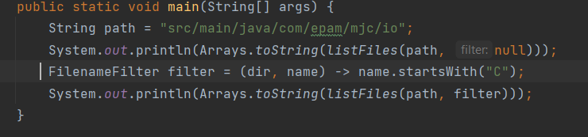
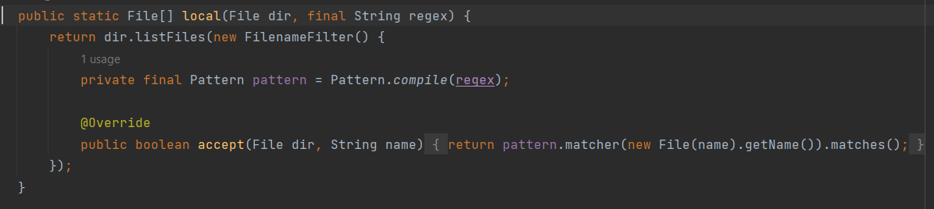
Filename filter
FilenameFilter is an interface in Java that is used to filter file names, such as those returned from a call to a File object's listFiles() method. If listFiles() is called with no parameters, it returns all File objects in a directory.

Slide 12
NIO
The java.nio package was introduced in Java 1.4 and updated in Java 1.7 (NIO.2) with enhanced file operations. It provides:
Buffer – to read chunks of data at a time
CharsetDecoder – for mapping raw bytes to/from readable characters
Channel – for communicating with the outside world
Selector – to enable multiplexing on a SelectableChannel and provide access to any Channels that are ready for I/O
non-blocking mode – to read whatever is ready.
Files and Paths classes with useful static methods.

Slide 13
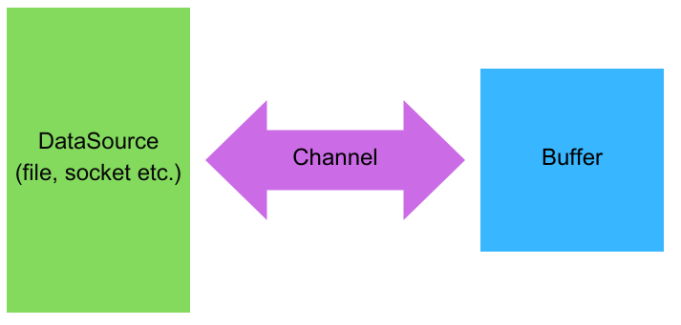
NIO
Buffer
A buffer can be seen as a space in memory. It can reside in the main memory of the JVM, the heap or off-heap, which is very useful for very large buffers.
Channel
The channel is where the data comes from. The channel object is an object that connect to a file or to a socket, for instance. A channel can write the buffer to the medium or can read data from that medium to a buffer.
A channel only knows bytes buffers, so it can only read and write bytes from files or for socket, for instance. Afterwards, we have to convert the content of this buffer to characters if this is a character buffer or to data or object if it is raw data or raw objects.

Slide 14
NIO Channel
The channel is an interface and is implemented by several classes.
The first one is FileChannel to access files.
It has a cursor. It allows for multiple reads and writes. It is thread safe.
The second is DatagramChannel to access to socket.
It supports multicast since it is UDP and it supports multiple, non-concurrent reads and writes.
The third one is the SocketChannel and ServerSocketChannel to access to a TCP socket.
It supports asynchronous operations and also supports multiple, non-concurrent reads and writes.
FileChannel, SocketChannel, and ServerSocketChannel are in fact, abstract classes extended by concrete classes in the JDK. But these implementations are hidden and should not be used directly.
To create an instances of Channels, we are going to use factory methods.
A FileChannel can be mapped to a memory array for direct access. This allows for much faster operation than accessing to the disk directly. It is built on native features provides by the different operating system and this is the reason why the concrete implementation of FileChannel are hidden just because they are different depending on the machine we are working on.
It should be used with caution because a single write in this kind of array can trigger a modification of the file that will be send to the disk directly.
There are 3 modes of this mapping:
READ_ONLY: the mapped file cannot be modified.
The file is just loaded in memory and is read from this array.
READ_WRITE: the file can be modified with the previous warning.
PRIVATE: modifications are local to this channel and will not be propagated to the disk.

Slide 15
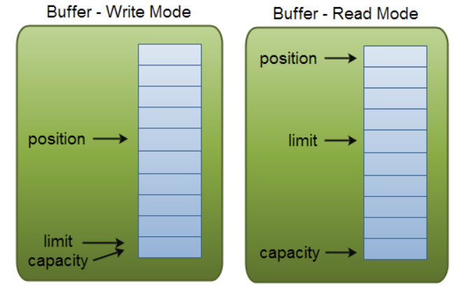
NIO Buffer
A buffer is an in-memory structure backed by an array of bytes. It is usually stored in the central memory of the JVM, handled by the garbage collector. But it can also be stored in the off-heap space of the JVM, thus not impacting the garbage collector. This is very useful for very large buffers. The size of buffer is an Int since it is backed by an array. So the size of a buffer can be as large as two gigabytes which could have an impact on the performance of the garbage collector if stored in the central memory space of the JVM.
A buffer object has 3 properties:
a capacity = the size of the backing array.
a current position that can be seen as cursor. All the read and the write operations are made to or from the current position.
a limit which is the last position in memory seen by this buffer.

Slide 16
Further readings
Oracle tutorials
Decorator Pattern
"Thinking in Java" by Bruce Eckel

